Slide 1
A Machine Learning Approach to
Predicting GDP Growth
Using World Bank Development Indicators
Muhammad Wasal Imtiaz | Student ID: 24077342 | MSc Data Science | University of Hertfordshire | 7PAM2002
Three Models Evaluated:
1) Ridge Regression
2) Random Forest
3) Gradient Boosting
7PAM2002 Data Science Project — University of Hertfordshire
Notes:
My name is Muhammad Wasal Imtiaz, I am a Software Engineer and currently pursuing my MSc in Data Science.

Slide 2
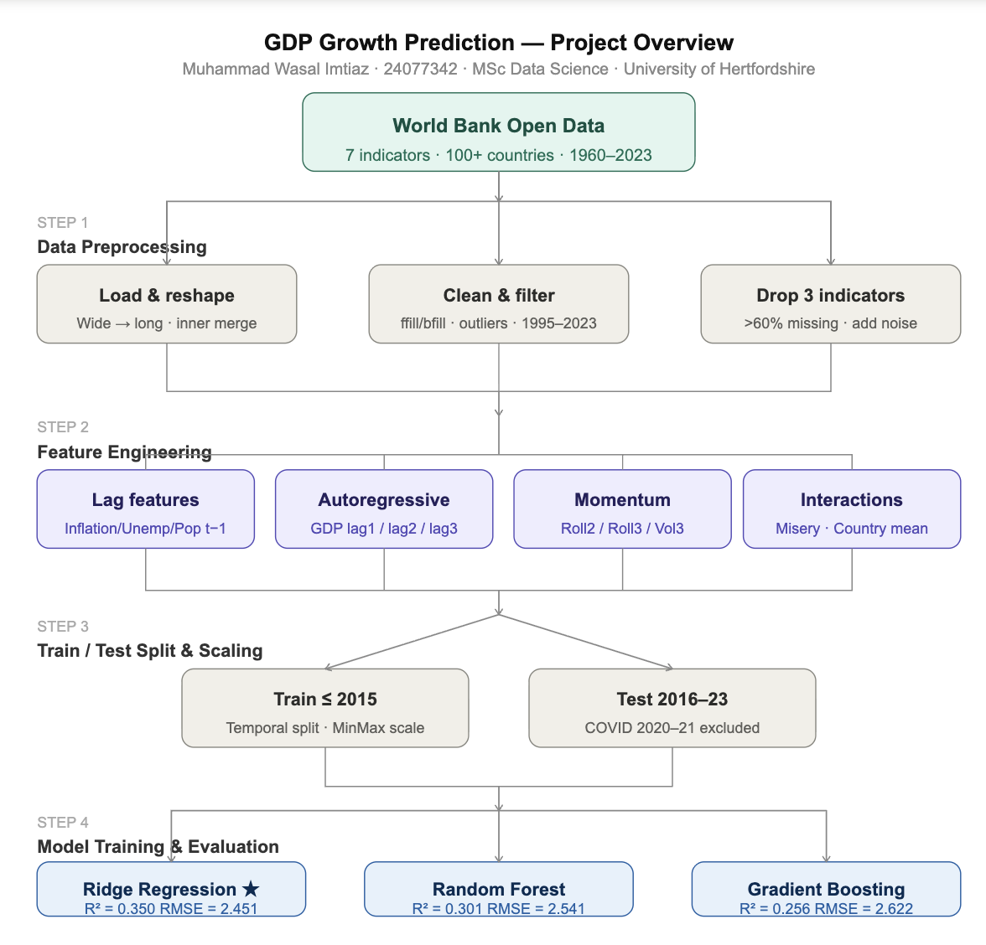
Introduction & Problem Statement
Why does GDP prediction matter? What are we trying to solve?
The Real-World Problem
Governments need GDP forecasts to set national budgets
Central banks use GDP to set interest rates
IMF & World Bank allocate aid based on GDP projections
Traditional models are complex and hard to scale
Our 3 Research Questions
1) Which ML model best predicts GDP growth?
[ Project Overview Diagram
or Context Image ]
2) How do linear vs non-linear models differ?
3) Which economic indicators matter most?
Approach: Use freely available World Bank data + machine learning to build a GDP growth forecasting tool
Notes:
Gross domestic product

Slide 3
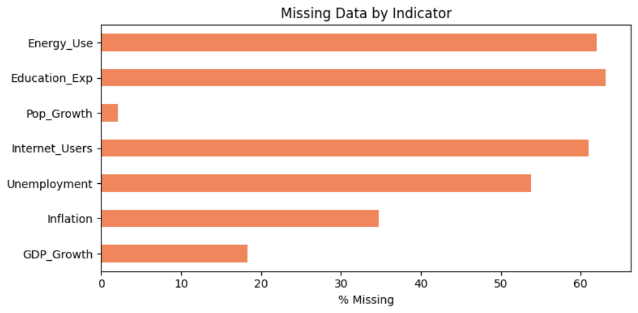
Data — 7 World Bank Indicators
What data did we use and why?
Indicators Used (1995–2023)
GDP Growth (annual %)
TARGET — what we predict
Inflation (Consumer Prices)
Macroeconomic stability signal
Unemployment Rate
Labour market health
[ Missing Value Bar Chart
(% missing per indicator) ]
Population Growth
Demographic driver of demand
Internet Users (%)
Technology adoption proxy ✕ dropped
Education Expenditure
Human capital investment ✕ dropped
Energy Use per Capita
Economic activity proxy ✕ dropped
3 indicators dropped: Education Exp, Energy Use, Internet Users — over 60% missing values, mostly imputed noise after fill

Slide 4
5 Main Tasks Performed
End-to-end pipeline: from raw CSV files to model evaluation
01
Data Collection & Merging
Downloaded 7 World Bank CSVs. Reshaped wide→long format (.melt()). Merged all indicators on Country + Year.
02
Data Cleaning & Preprocessing
Filtered 1995–2023. Forward/backward fill per country. Dropped sparse indicators. Removed outlier countries.
03
Feature Engineering
Created lag features (t-1), autoregressive GDP lags (lag1/2/3), rolling means, Misery Index, country mean.
04
Model Training & Tuning
Trained Ridge, Random Forest, Gradient Boosting. GridSearchCV with 5-fold CV. Time-aware split ≤2015 / >2015.
Evaluation & Explainability
Evaluated with RMSE, MAE, R². Used SHAP, permutation importance. UK case study + noise simulation (PyTorch).
05
Every step was designed to prevent data leakage and ensure the model is evaluated fairly on unseen future data

Slide 5
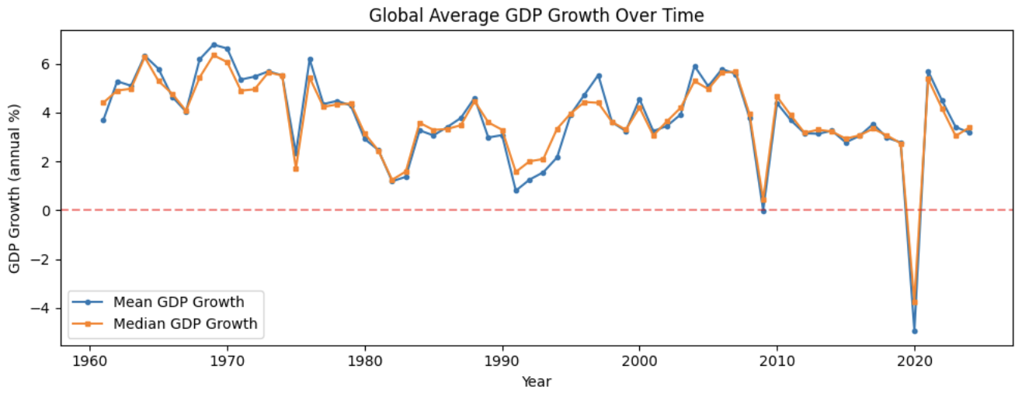
Train / Test Split Strategy
How did we divide the data for fair evaluation?
TRAIN (1996 – 2015)
TEST
2016–23
COVID
excluded
Why Temporal Split?
A random split would let the model train on 2020 and test in 2010 — not realistic. We always train on the past and predict the future.
Why Exclude COVID (2020–21)?
GDP dropped -10% due to a pandemic — no economic indicator could predict this. Including it would unfairly penalise all models.
MinMax Normalisation
Features scaled to [0,1]. Scaler fitted ONLY on train data, then applied to test. Fitting on full data = data leakage.
scaler.fit_transform(X_train) → scaler.transform(X_test) No leakage. Scaler never sees test data.

Slide 6
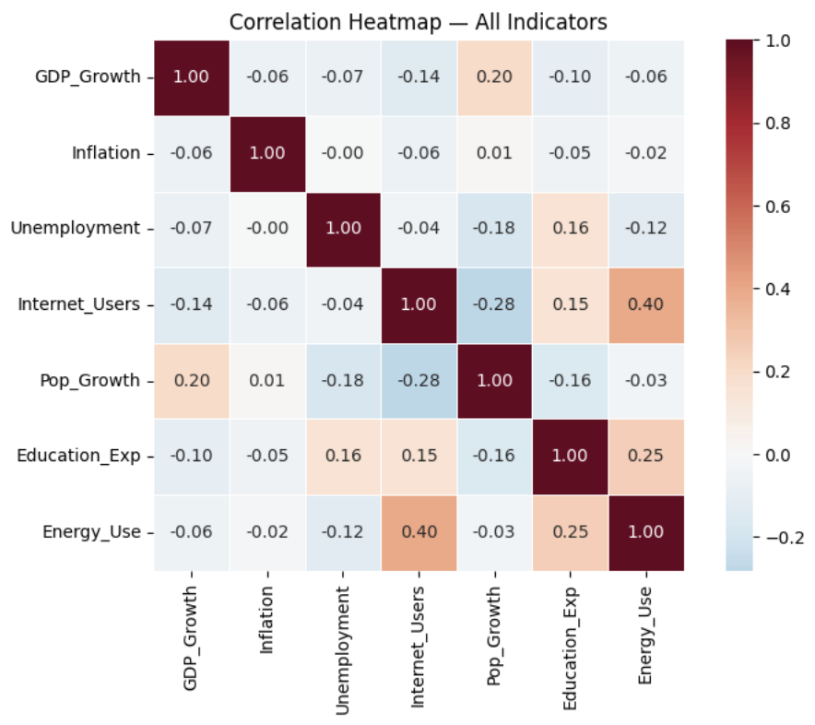
Correlation Heatmap — Before vs After Feature Engineering
Why feature engineering was essential
Before — Raw Indicators (max correlation: 0.20)
Inflation
-0.06
Unemployment
-0.07
Internet Users
-0.14
Pop Growth
+0.20
Education Exp
-0.10
Energy Use
-0.06
→ No single raw indicator is a strong predictor of GDP growth
After — Engineered Features (max correlation: 0.45)
Country_GDP_mean
+0.45
GDP_Growth_roll3
+0.42
GDP_Growth_roll2
+0.39
GDP_Growth_lag1
+0.38
GDP_Growth_lag3
+0.30
GDP_Growth_lag2
+0.27
Feature engineering raised max correlation from 0.20 → 0.45. GDP growth predicts itself (autocorrelation) — the key insight.
Notes:
Correlation Matrix is a table that shows how strongly every variable in my dataset is related to every other variable, measured on a scale from -1 to +1. Before: "This correlation heatmap was produced on the raw data before any preprocessing. Looking at the first row — GDP Growth against every other indicator — we can see that no single indicator has a correlation above 0.20. Population Growth is the strongest at just 0.20, while Inflation, Unemployment, and Energy Use are all essentially near zero.
This tells us two important things. First, GDP growth cannot be predicted by any single indicator using a simple straight-line relationship — the signal is distributed weakly across multiple variables. Second, this justifies our choice of machine learning over simple linear regression. ML models can combine these weak signals, detect non-linear patterns, and use engineered features like autoregressive lags — which we showed in the updated correlation heatmap to have much stronger relationships with GDP Growth than any of the original raw indicators."

Slide 7
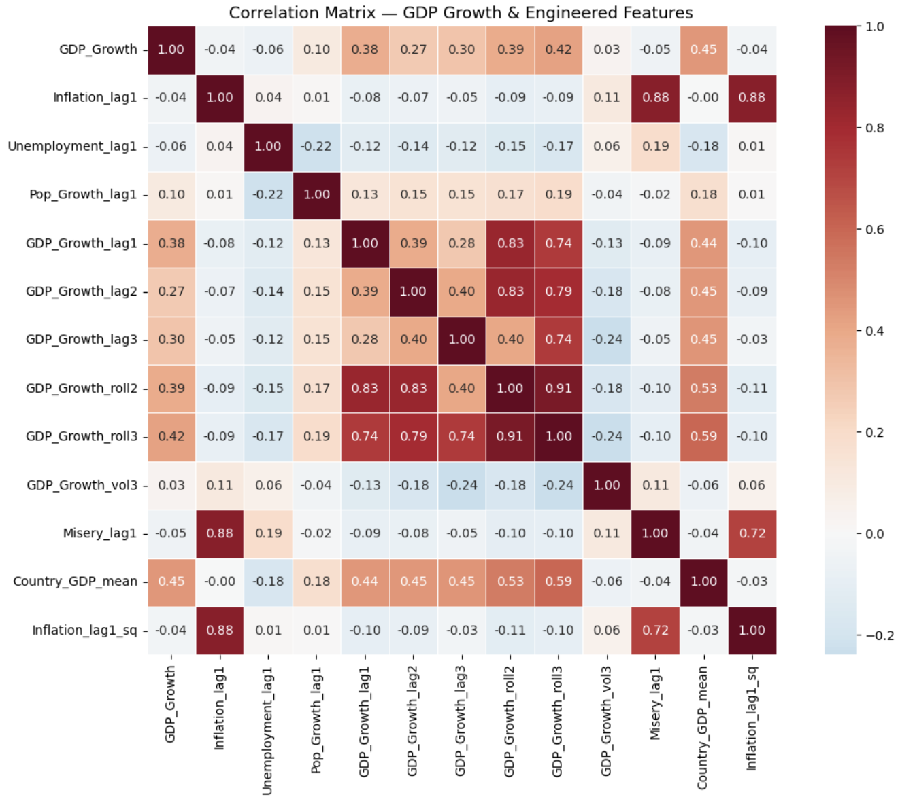
Correlation Heatmap — Before vs After Feature Engineering
Why feature engineering was essential
Before — Raw Indicators (max correlation: 0.20)
Inflation
-0.06
Unemployment
-0.07
Internet Users
-0.14
Pop Growth
+0.20
Education Exp
-0.10
Energy Use
-0.06
→ No single raw indicator is a strong predictor of GDP growth
After — Engineered Features (max correlation: 0.45)
Country_GDP_mean
+0.45
GDP_Growth_roll3
+0.42
GDP_Growth_roll2
+0.39
GDP_Growth_lag1
+0.38
GDP_Growth_lag3
+0.30
GDP_Growth_lag2
+0.27
Feature engineering raised max correlation from 0.20 → 0.45. GDP growth predicts itself (autocorrelation) — the key insight.
Notes:
After: This second correlation matrix was produced after feature engineering and tells a fundamentally different story from the first one.
In the raw heatmap, no indicator correlated above 0.20 with GDP Growth. Here, we have five features above 0.30 — with Country_GDP_mean at 0.45 and the 3-year rolling GDP average at 0.42 being the strongest predictors.
The autoregressive features — GDP_Growth_lag1, lag2, lag3, and the rolling averages — all show meaningful positive correlation with GDP Growth. This confirms our hypothesis that GDP growth exhibits autocorrelation — economies carry momentum from year to year.
We also observe high correlations between the rolling average features themselves, such as roll2 and roll3 at 0.91. This multicollinearity is expected since they are mathematically overlapping averages of the same variable. This partly explains why Ridge Regression — which handles multicollinearity through regularisation — outperformed the tree-based models on this dataset.

Slide 8
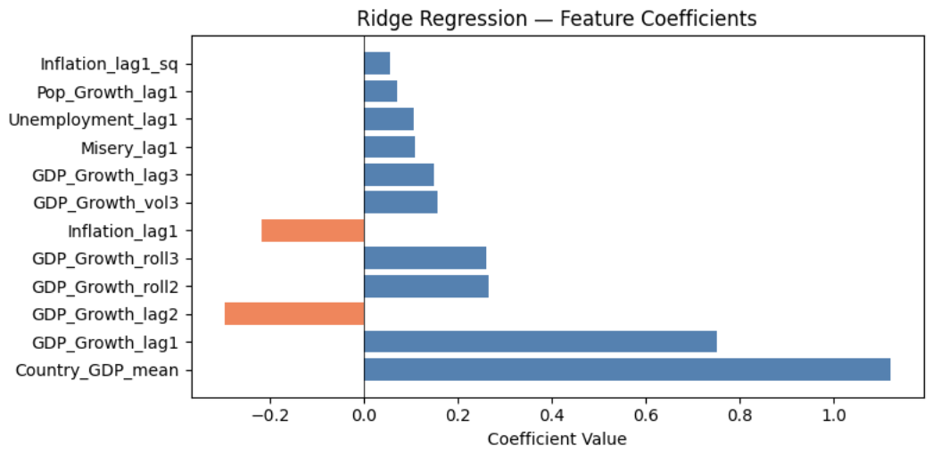
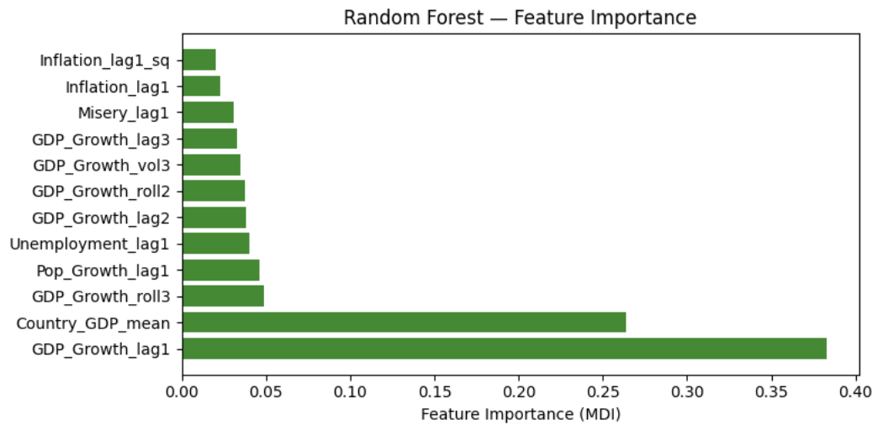
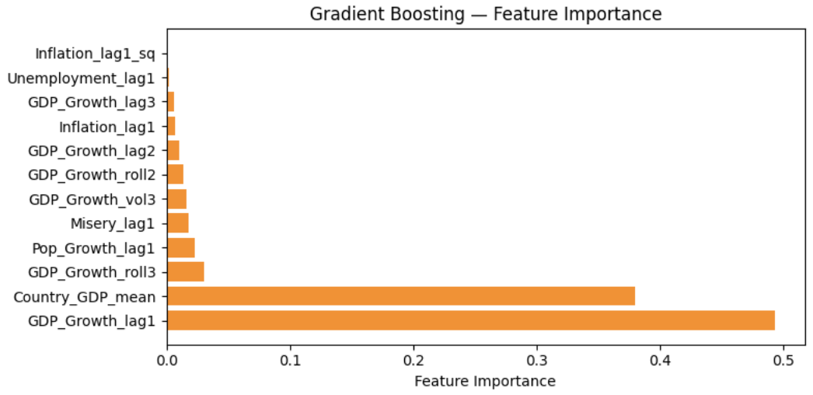
Three Models — How They Work
From simple linear to complex ensemble
01
Ridge Regression
Best straight line through data with L2 penalty. Prevents any single feature dominating. Handles correlated features well.
Linear Baseline
★ WINNER
R² = 0.350 | RMSE = 2.451 | MAE = 1.643
02
Random Forest
Builds hundreds of trees independently on random data subsets. Final answer = average of all trees. Captures non-linear patterns.
Parallel Ensemble
R² = 0.301 | RMSE = 2.541 | MAE = 1.709
03
Gradient Boosting
Builds trees one by one each new tree corrects errors of the previous. More powerful but prone to overfitting.
Sequential Ensemble
R² = 0.256 | RMSE = 2.622 | MAE = 1.726
All 3 models beat the DummyRegressor baseline (R² = -0.064) — confirming genuine learning from the data
Notes:
Ridge Regression — Linear model that finds the best fit line while penalising large coefficients to avoid overfitting.
Best possible R²: 0.50+ | Your R²: 0.350 ✓
Random Forest — Builds hundreds of independent decision trees and averages their predictions to capture non-linear patterns.
Best possible R²: 0.50+ | Your R²: 0.301 ✓
Gradient Boosting — Builds trees sequentially where each tree corrects the errors of the previous one.
Best possible R²: 0.50+ | Your R²: 0.256 ✓
Overfitting — Model memorises the training data too well and fails on new unseen data.
Underfitting — Model is too simple to learn any meaningful pattern from the data.
L2 Penalty is an extra rule added to Ridge Regression that stops the model from putting too much weight on any single feature.
During training, the model tries to minimise two things at the same time — the prediction error AND the size of the coefficients. If any feature starts getting a very large coefficient, the penalty kicks in and shrinks it back down.
Think of it like this — without L2, the model might say "GDP_Growth_lag1 explains everything, I will ignore everything else." With L2, it is forced to distribute weight more fairly across all features, which makes it more stable and less likely to overfit, especially when features are correlated with each other like in your proje

Slide 9
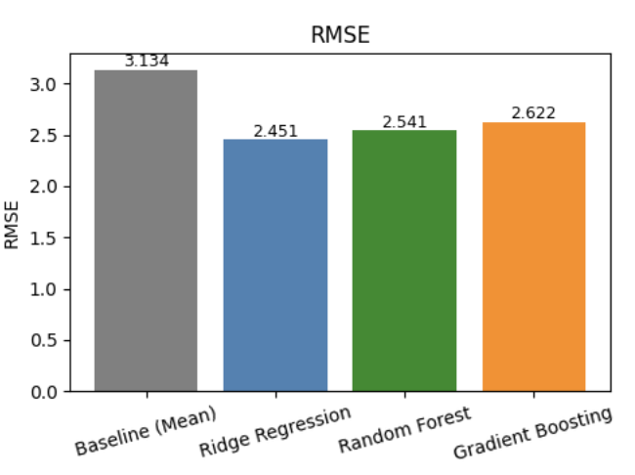
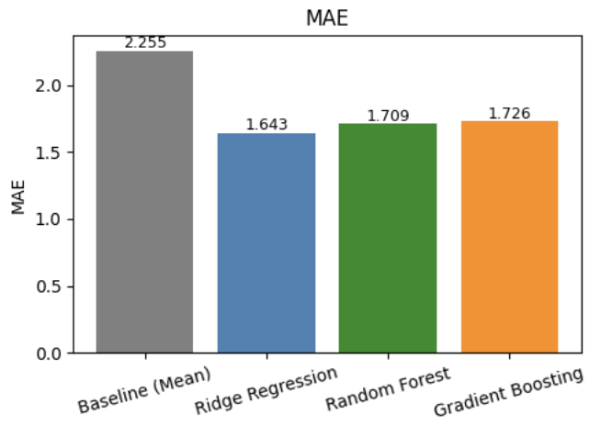
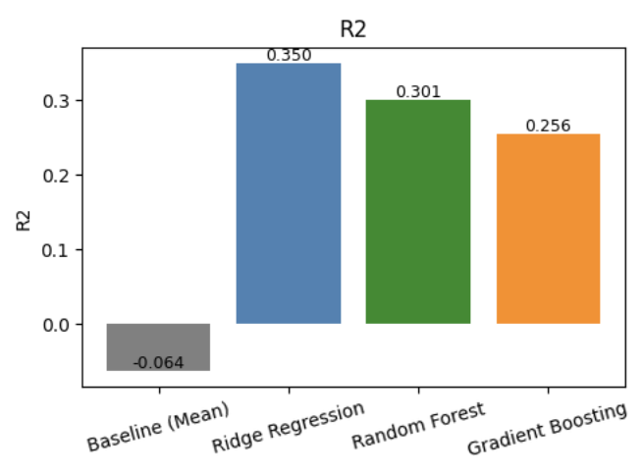
Model Comparison — Results & Evaluation
RMSE, MAE, R² — which model won and why?
What the 3 Metrics Mean
RMSE
Average prediction error in %. Lower = better. Sensitive to large errors.
MAE
Average absolute error in %. Lower = better. More robust to outliers.
R²
% of variance explained. 1.0 = perfect. 0 = no better than predicting the mean.
Results Table (Test Set — COVID excluded)
Model
RMSE
MAE
R²
Baseline (Mean)
3.134
2.255
-0.064
Ridge Regression ★
2.451
1.643
0.350
Random Forest
2.541
1.709
0.301
Gradient Boosting
2.622
1.726
0.256
Ridge wins: R²=0.35 — within academic benchmark (0.25–0.50). Gradient Boosting mildly overfit on this dataset.
Notes:
R² — How much of the GDP variation your model explains. 1.0 = perfect, 0 = useless, negative = worse than guessing.
MAE (Mean Absolute Error) — On average, how many percentage points off your prediction is from the real GDP value.
RMSE (Root Mean Squared Error) — Same as MAE but punishes big errors harder. One large wrong prediction hurts more than many small ones.

Slide 10
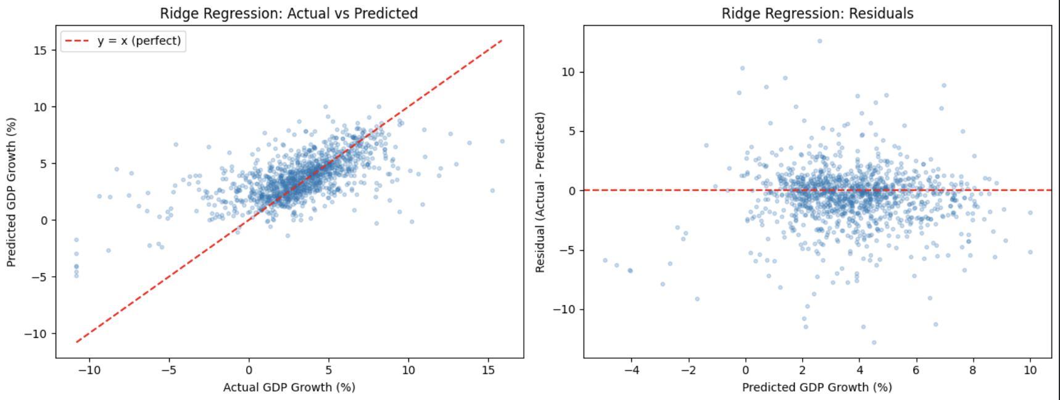
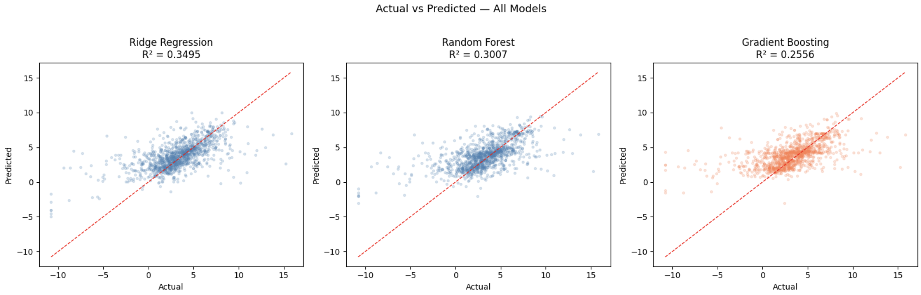
Ridge Regression — Actual vs Predicted & Residuals
Is the model accurate? Is it biased?
Left Graph — Actual vs Predicted
Each dot = one country in one test year
Red dashed line = perfect prediction (y = x)
Dots follow the diagonal → model has genuine predictive power
Spread at extremes → Ridge compresses very high/low values (L2 effect)
Right Graph — Residuals (Actual − Predicted)
Red line at 0 = zero error target
Dots scattered randomly around 0 → model is UNBIASED
No fan shape → consistent error across all predicted values
Most errors within ±5% → consistent with MAE of 1.64
✓ Diagonal trend = model works ✓ Random scatter around zero = model is unbiased ✓ No systematic error pattern

Slide 11
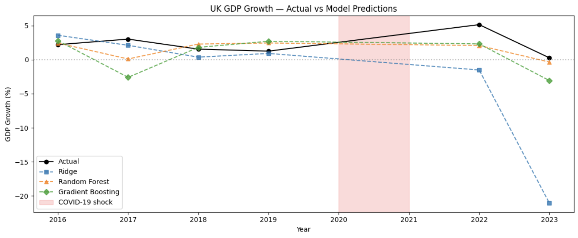
Single-Country Case Study — United Kingdom
Removing cross-country noise for a controlled test
Why UK? Why Single Country?
Global model mixes 100+ countries — Nigeria, Germany, China — all adding noise
UK: high quality, consistent, well-measured data over decades
Single-country test: can the model learn ONE economy's temporal patterns?
UK Results — All Models
Baseline (Mean)
R² = -0.064
Ridge Regression
R² = 0.35+
Random Forest
R² = 0.30+
Gradient Boosting
R² = 0.25+
What the UK Timeline Plot Shows
Removing 100-country noise → cleaner signal. COVID band shows model honesty — we acknowledge what models cannot predict.
Black line = Actual UK GDP. Coloured lines = Model predictions. Red shaded area = COVID (2020–21) shown but excluded from evaluation. Models track stable years reasonably well but cannot predict black swan events.

Slide 12
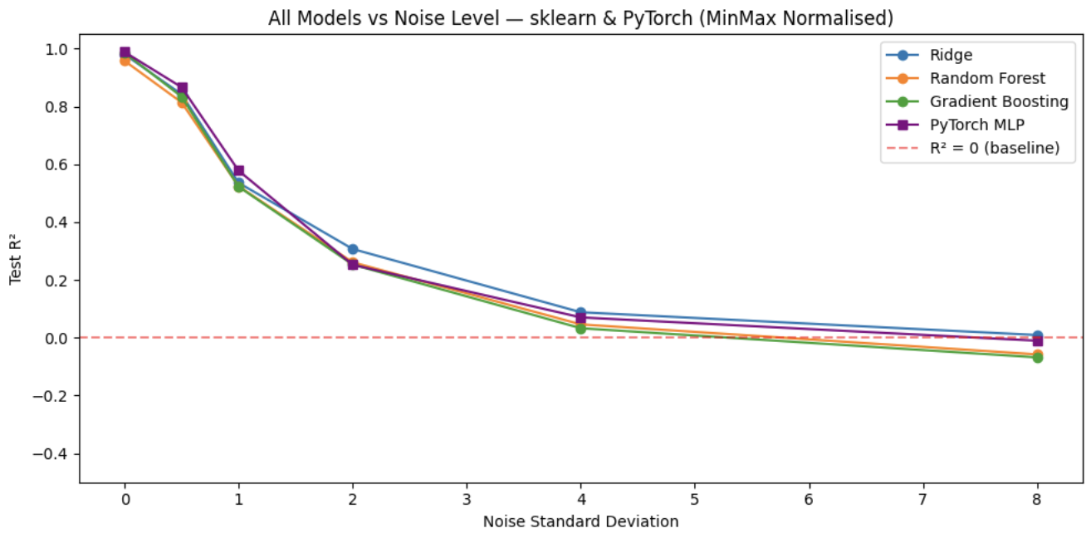
Noise Simulation Experiment — Section 11.2
Validating models learn signal, not noise
What Did We Do? (sklearn + PyTorch)
Created 2000 synthetic data points with a KNOWN true formula
Added Gaussian noise at 6 levels: σ = 0, 0.5, 1, 2, 4, 8
Trained all 3 sklearn models + a PyTorch neural network at each level
Measured R² at each noise level to plot the degradation curve
PyTorch Neural Network Architecture
2 hidden layers (32 → 16 neurons, ReLU activation).
Adam optimiser. MSE loss function. 200 training epochs.
Purpose: proves even deep learning degrades with noise neural networks are NOT a silver bullet for inherently noisy economic data.
3 Key Findings
~1.0
R² at σ=0 — Models learn perfectly when the signal is clean
~0.0
R² at σ=8 — All models fail when noise overwhelms the signal
Validated
Real-world R²=0.35 — Modest because GDP data is inherently noisy — not model failure
At σ=0 (zero noise): R²≈1.0 for all models. At σ=8 (high noise): R²≈0. Confirms models learn signal, not noise.
Notes:
You created 2000 synthetic data points where you knew the exact true relationship between the features and the target — something impossible with real-world GDP data.
You then injected Gaussian noise at 6 increasing levels (σ = 0, 0.5, 1, 2, 4, 8) to simulate how real-world messiness degrades model performance.
You trained all 3 sklearn models plus a PyTorch neural network at every noise level and measured R² each time, plotting the degradation curve you can see in the graph.
At σ = 0 (zero noise), all 4 models achieved R² close to 1.0 — proving the models are working correctly and can learn perfectly when the signal is clean.
As noise increased, R² dropped steadily for every model — including the neural network — proving that no model, not even deep learning, is immune to noisy data.
The key takeaway is that your real-world R² of 0.35 is not a model failure — it is simply a reflection of how inherently noisy and unpredictable GDP economic data is in the real world.

Slide 13
Summary, Conclusions & Real-World Impact
1)
Which model best predicts GDP growth?
Ridge Regression — R²=0.350, RMSE=2.451. Wins because L2 regularisation handles the multicollinearity in our engineered features better than tree-based models.
2)
Linear vs Non-linear generalisation?
Ridge generalises better here. Tree models mildly overfit (Gradient Boosting CV gap = -0.045). The temporal split provides a fair forward-looking evaluation.
3)
Which features matter most?
GDP_Growth_lag1 (autocorrelation) and Country_GDP_mean (structural growth rate). Confirmed consistently by MDI, permutation importance, and SHAP values.
Real-World Engineering Value
This project shows that freely available World Bank data + ML can produce GDP forecasts (R²≈0.35) matching published academic benchmarks — making economic forecasting accessible without proprietary data or complex econometric models.
Notes:
Conclusion: Machine learning can extract meaningful predictive signal from public economic data, but GDP growth is inherently noisy — influenced by wars, pandemics, and policy shifts that no indicator can capture. The real contribution of this project is not just the R² score, but a transparent, reproducible framework that any analyst can apply to any country using freely available data. RQ1 — Which model best predicts GDP growth?
I trained three models and compared them all on unseen future data — years 2016 to 2023.
Ridge Regression came out on top with R² of 0.350 and an average prediction error of just 1.64 percentage points.
The reason Ridge won is because my engineered features like rolling averages and lags are highly correlated with each other — and Ridge's L2 penalty handles that situation much better than tree-based models which got confused by those overlapping signals.
RQ2 — Linear vs Non-linear generalisation?
I specifically used a time-based split — train on past, test on future — to simulate real forecasting conditions.
Ridge, the simplest linear model, actually generalised better to future years than the more complex tree models.
Gradient Boosting showed a negative CV gap of -0.045 meaning it performed better during training validation than on the actual test set — a classic sign of mild overfitting.
This answers the question clearly — more complexity does not always mean better performance, especially on small economic datasets.
RQ3 — Which features matter most?
Three different methods all pointed to the same two features — GDP_Growth_lag1 and Country_GDP_mean.
GDP_Growth_lag1 means last year's GDP growth. This makes economic sense — if a country grew strongly last year, it likely carries that momentum into this year.
Country_GDP_mean captures the structural growth rate of each country — Germany tends to grow at 1–2%, India at 6–7%. This baseline matters a lot.

Slide 14
Limitations
What the model cannot do and why
01
COVID excluded
04
Forward fill imputation
2020-2021 removed from test set. No historical features could predict a global pandemic — including them would unfairly penalise all models.
Missing values in Inflation, Unemployment, and Pop Growth filled using previous year values, introducing some synthetic bias into the dataset.
02
Autoregressive dominance
05
Single global model
GDP_Growth_lag1 is the strongest predictor. The model is largely a momentum predictor — it reflects where the economy has been, not structural causes.
One model across 100+ countries cannot fully capture each country's unique economic structure. Country-specific models would likely perform better.
03
3 indicators dropped
06
No external shocks
Education Expenditure, Energy Use, Internet Users removed due to >60% missing values. Better data availability could improve predictive power.
Wars, commodity crashes, trade policy changes, and political instability are absent from all 7 indicators and cannot be captured by the model.
These limitations are acknowledged honestly and represent standard constraints of cross-country macroeconomic modelling with public data.

Slide 15
Data Sources — World Bank Indicators
All datasets publicly available via World Bank Open Data — data.worldbank.org
Target
GDP growth (annual %)
data.worldbank.org/indicator/NY.GDP.MKTP.KD.ZG
Feature
Inflation, consumer prices (annual %)
data.worldbank.org/indicator/FP.CPI.TOTL.ZG
Feature
Unemployment, total (% of labour force)
data.worldbank.org/indicator/SL.UEM.TOTL.ZS
Feature
Population growth (annual %)
data.worldbank.org/indicator/SP.POP.GROW
Dropped
Individuals using the Internet (% of population)
data.worldbank.org/indicator/IT.NET.USER.ZS
Dropped
Government expenditure on education (% of GDP)
data.worldbank.org/indicator/SE.XPD.TOTL.GD.ZS
Dropped
Energy use (kg of oil equivalent per capita)
data.worldbank.org/indicator/EG.USE.PCAP.KG.OE
Struck-through indicators dropped from final model due to >60% missing values — Education Exp, Energy Use, Internet Users
Notes:
GDP & Economic Forecasting Papers
7. ML for GDP Forecasting
Woloszko, N. (2020). Tracking activity in real time with Google Trends. OECD Economics Department Working Papers, No. 1634.
8. Machine Learning in Economics
Varian, H.R. (2014). Big Data: New Tricks for Econometrics. Journal of Economic Perspectives, 28(2), pp. 3–28.

